Slide 1
Front Motors
Motor board
Motor board
12V Regulator
Rear Motors
Rear Enclosure
Pedals
5v Power Bank
Steering Motor
Steering Driver
Steering Control
MCU
Camera
Battery
Steering Feedback
Steering Subsystem (front)
Pi
Isolator
Fuse
Battery
WiFi
GPS
Steering Wheel
Battery Box
Sonar Modules
Sonar MCU
Video Monitor
Brake Switch
Local / Remote Mode
D / N / R Switch?
Bump Switches
Pi/Steering enclosure
Lights addressable?
Cockpit Controls
Power
Signal

Slide 2
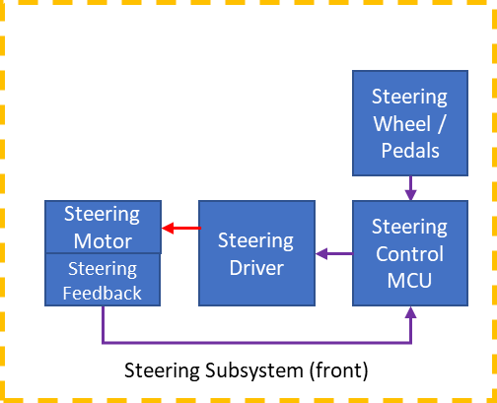
Steering Subsystem (front)
Brake Switch
Pedals
Steering Wheel
L R
Front
Motor board
+12V
5V
GND
5V
GND
5V
+12V
Steering
Driver
0V
0V
RPWM
D9
A6
A2 A3
A0
LPWM
D10
Steering Control
MCU
5V REG
Divider
R_EN/L_EN
D11
USB
A4
R_IS/L_IS
A5
VCC
5V
GND
Steering Motor
Estop
Relay
ESTOP loop
Steering Feedback
GND
D8
A1
ESTOP loop
5V
D5
10K PD
D6 10K PD
D7
10K PD
Steering Subsystem board
5V
5V
Local / Remote Mode
D / N / R Switch?

Slide 3
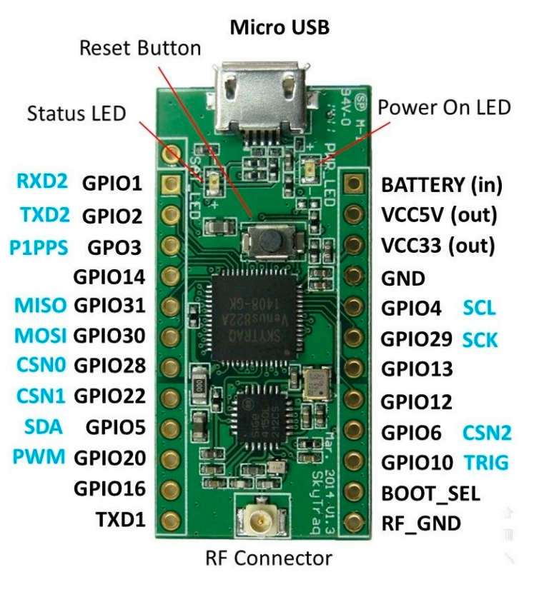
Steering Subsystem (front)
HC-SR04 i2c
VCC
Sonar Subsystem board
SCL
SC0
+12V
SDA
TCA9548A
GND
SD0
0V
HC-SR04 i2c
VCC
SCL
GPIO4
Sonar MCU
NavSPARK
SCL
SC1
SDA
GPIO5
SDA
SD1
GND
USB
HC-SR04 i2c
VCC
SCL
SC2
SDA
SD2
GND
VCC
3V3
HC-SR04 i2c
VCC
GND
SCL
SC3
SDA
SD3
GND
BOOT_SEL
JMP
Front Sw
RF_GND
GPIO12
Pulldn
GPIO13
Pulldn
Rear Sw
GPS
ANT

